Slide 1

Building the Construction Activities Dictionary – Making machines understand word choices in construction
Capstone 2 Viva Presentation
By
Chua Wen Soong (18032573)
Bachelor of Science (Honours) Information Systems (Business Analytics)

Slide 2
Acknowledgements
Prof Sian Lun Lau
For his care and guidance in leading me through this project.
Mr Ziqing Liew
For providing the construction data and scoping the problem.

Slide 3
Introduction

Slide 4
Problem of PlainText data in Documentation
Documentation is common in all industries.
On large projects, they tend to become very tedious to go through.
Digital documents supports basic search function.
How can search engines give so much information compared to basic search functions?
Natural Language Processing (NLP) is used.
Thus, what if we used NLP on specialised industries so that machines can understand human language better?
Chua Wen Soong
Capstone Viva Presentation 25/11/2021
Notes:
The reason I worked on the topic.

Slide 5
Problem Scope
Large construction documents are tedious to go through manually
Machines are not useful in returning informational searches
Machines have no way of understanding human language (as there is no construction lexicon)

Slide 6
Objectives
Building a language model of the construction industry
Have word representations for construction terms
The language model is to be applicable for downstream NLP tasks
Notes:
Needs to be measurable

Slide 7
Literature Review

Slide 8
What is NLP all about?
NLP is a subfield, combining the areas of linguistics, computer science, and artificial intelligence that aims toward learning, understanding, recognizing, and producing human language content (Hirschberg & Manning, 2015)

Slide 9
Applications of NLP
Word sense disambiguation
Machine Translation
Summarization
Syntactic Annotation
Named Entity Recognition

Slide 10
Examples of NLP Applications for Specialised Fields
The medical industry has publicly available medical datasets and working models working on text classification (Weng et al., 2017).
Information extraction on regulation for construction management systems (Zhang & El-Gohary, 2016)
Article classification for dengue research (Li et al., 2020)

Slide 11
Problems in NLP
Indurkhya et al. (2010) states “It is universally acknowledged that ordinary language use involves a more or less seamless integration of linguistic knowledge, cultural conventions, and real-world knowledge” (p. 94).
}
Context
Polysemy – HOT
Homonymy – night, light
Word Semantics

Slide 12
Solutions to these problems
Lexicons
Wordnet
FrameNet
Levin’s Classes
Machine Learning through Vector Representations
Word2Vec
Glove
ELMo (Embeddings from Language Model)
BERT (Bidirectional Encoder Representations from Transformers)
Notes:
Comparison of different tools and summary

Slide 13
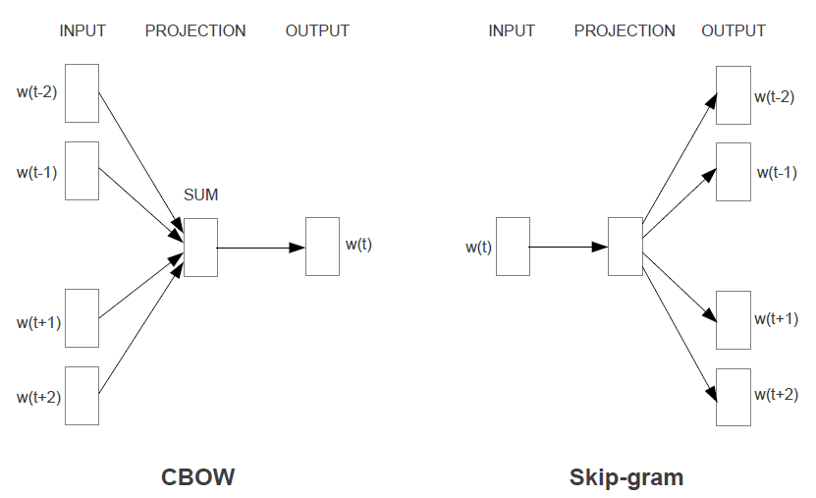
Word2Vec Architecture
(Mikolov et al., 2013)

Slide 14
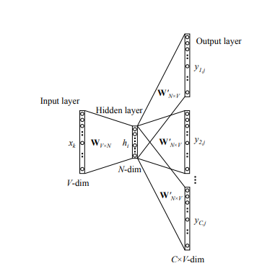
Word2Vec Architecture (Cont.)
Skip-gram Model
(Rong, 2015)

Slide 15
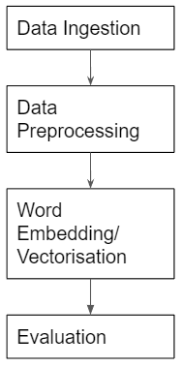
Methodology
Notes:
Reproducibility, good documentation can be useful for future work.

Slide 16
Data Ingestion
The Excel file with the construction data from 8 construction project is compiled into a single corpus.
The corpus consists of 50347 documents of short texts with lengths ranging from 1 to 16 words.
In total, there were 256, 556 words.

Slide 17
Data Preprocessing
The data was processed in the following 5 steps to produce Corpus A:
Removing punctuations, special characters, and stand-alone numbers
Lowercasing Text
Lemmatizing
Tokenization
(5.) A second corpus, Corpus B was made by following the previous steps in addition to removing all numbers.

Slide 18
Word Embedding/Vectorisation
Word2Vec
Word2Vec word embeddings were trained on Corpus A and Corpus B.
Word2Vec with Gensim Phraser
Gensim’s Phrase library was used to create bigrams and trigrams from words that appear frequently together. These n-grams were considered phrases. Then, Word2Vec was trained with the new vocabulary.
FastText
FastText is another implementation of Word2Vec that uses character n-grams instead.

Slide 19
Evaluation
Visualisation of word representations
The word representations of different word embedding techniques were visualised on a graph.
K-means clustering
Clustering was used to group words with similar vector similarities. The clusters were then examined if the words had any similar theme.

Slide 20
Evaluation (cont.)
Downstream Activity Words classifier prototype
A prototype for an ‘Activity’ word classifier was made. The different word embedding techniques were then evaluated by their effectiveness in classifying ‘activity’ words from the construction corpus using 10 base ‘activity’ words.
The base activity words are:
‘casting’, ‘drawing’, ‘plastering’, ‘proofing’, ‘tiling’, ‘widening’, ‘installation’, ‘laying’, ‘cabling’, ‘coating’

Slide 21

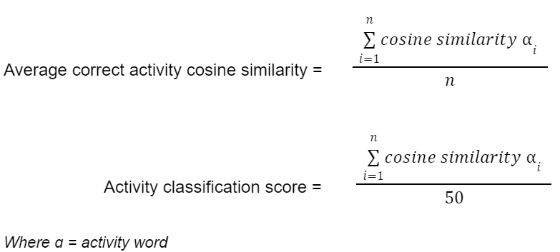
Evaluation measures
Word Similarity Measure
Downstream ‘Activity’ word Classifier Measures
(ACACS score)

Slide 22
Operational Definitions
Cosine Similarity: How similar the words are in the model
ACACS Score: measures how closely are the activity words in the corpus recognised by the trained word embedding technique
Activity classification score: measures the model overall performance in identifying similar activity words given the list of activity words

Slide 23
Downstream Activity Words Classifier Prototype Flow
Base Activity Word
Take top 5 Closest words by cosine similarity
Manually Identify Activity Words
Compute scores

Slide 24
Results

Slide 25
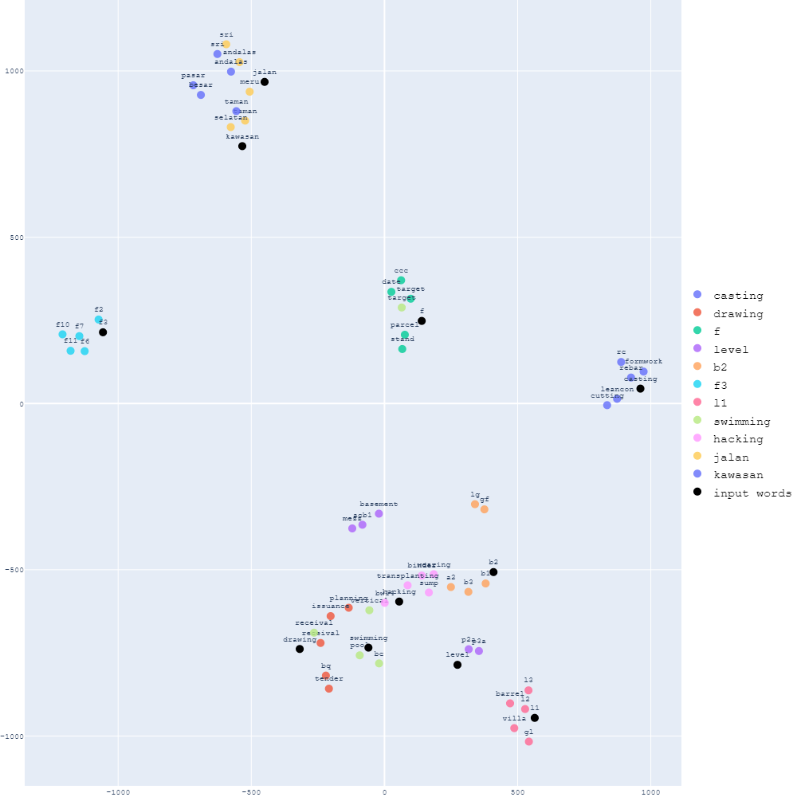
Word2vec similar words graph for Corpus A

Slide 26
General Comparison of Word Embedding Techniques
Word2Vec
Word2Vec with Gensim Phraser
FastText
Quick to deploy
Able to match similar words like locations together
f1, f2, f3 and so on
More contextual information
Identifies Malay names such as jalan_meru
Phrases like swimming_pool, do_sub are detected
Allows for OOV words
Biased towards grouping subword “-ing”
Typos have similar vectors to original word
‘Bondek’ vs ‘Bondeck’

Slide 27
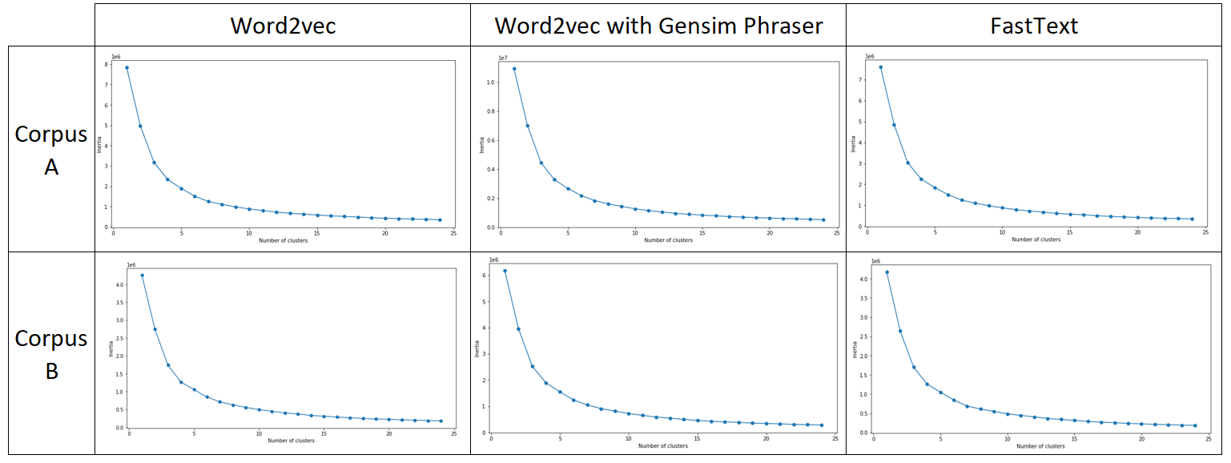
Elbow Plots for clustering

Slide 28
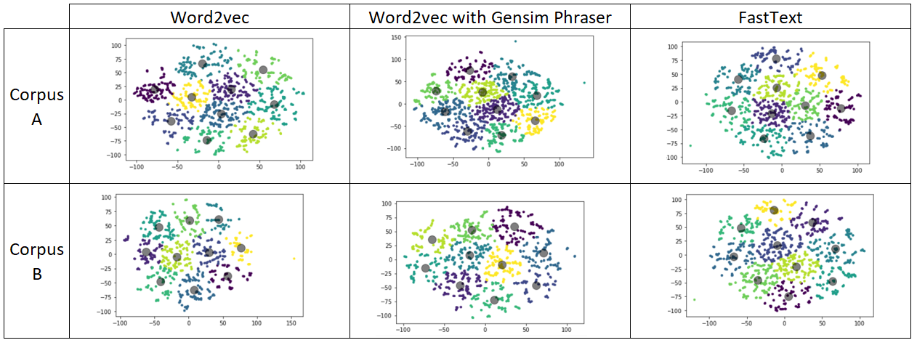
Cluster Maps for 10 clusters

Slide 29
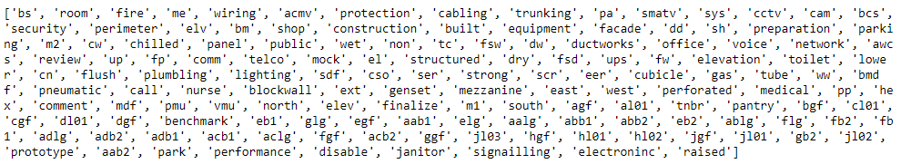
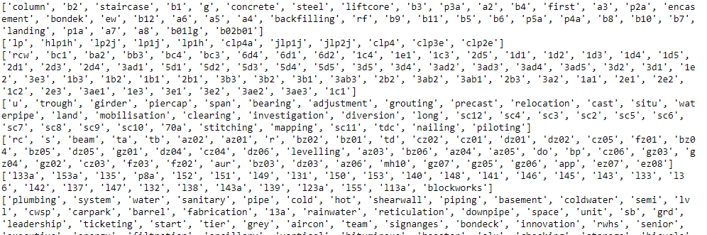
Comparison of 10 vs 50 clusters

Slide 30
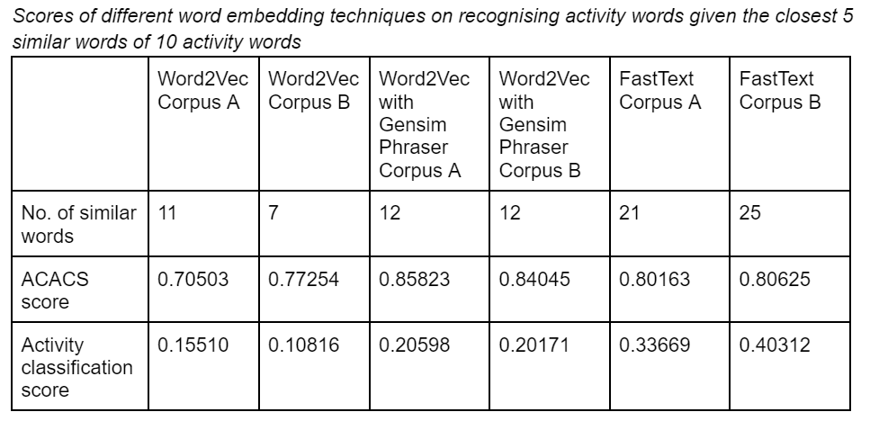

Slide 31
Evaluation measures
Word Similarity Measure
Downstream ‘Activity’ word Classifier Measures

Slide 32
Limitations
Poor Generalisation
Disproportionate Sampling
Small Corpus Size (256556 total words)
Cannot represent documents
Use Doc2Vec

Slide 33
Conclusion
Word embedding techniques like Word2Vec can be used to model languages for downstream NLP tasks in specialised industries.
Different word embedding techniques have different pros and cons.
When trying to classify ‘Activity’ words in this corpus, FastText gave best results.

Slide 34
Summary
A few word embedding techniques were trained on a construction corpus provided by SunCon.
They were able to somewhat model the construction language with only a small corpus.
Downstream NLP tasks like word or document classifiers could be built using these word embeddings.

Slide 35
References
Li, Z., Gurgel, H., Dessay, N., Hu, L., Xu, L., & Gong, P. (2020). Semi-supervised text classification framework: An overview of dengue landscape factors and satellite Earth Observation. International Journal of Environmental Research and Public Health, 17(12), 4509. https://doi.org/10.3390/ijerph17124509
Mikolov, T., Chen, K., Corrado, G., Dean, J. (2013). Efficient estimation of word representations in vector space. https://arxiv.org/abs/1301.3781
Rong, X. (2015). word2vec parameter learning explained. https://arxiv.org/abs/1411.2738
Weng, W.-H., Wagholikar, K. B., McCray, A. T., Szolovits, P., & Chueh, H. C. (2017). Medical subdomain classification of clinical notes using a machine learning-based natural language processing approach. BMC Medical Informatics and Decision Making, 17(1). https://doi.org/10.1186/s12911-017-0556-8
Zhang, J., & El-Gohary, N. M. (2016). Semantic NLP-based information extraction from construction regulatory documents for automated compliance checking. Journal of Computing in Civil Engineering, 30(2), 04015014. https://doi.org/10.1061/(asce)cp.1943-5487.0000346

Slide 36
Appendix

Slide 37
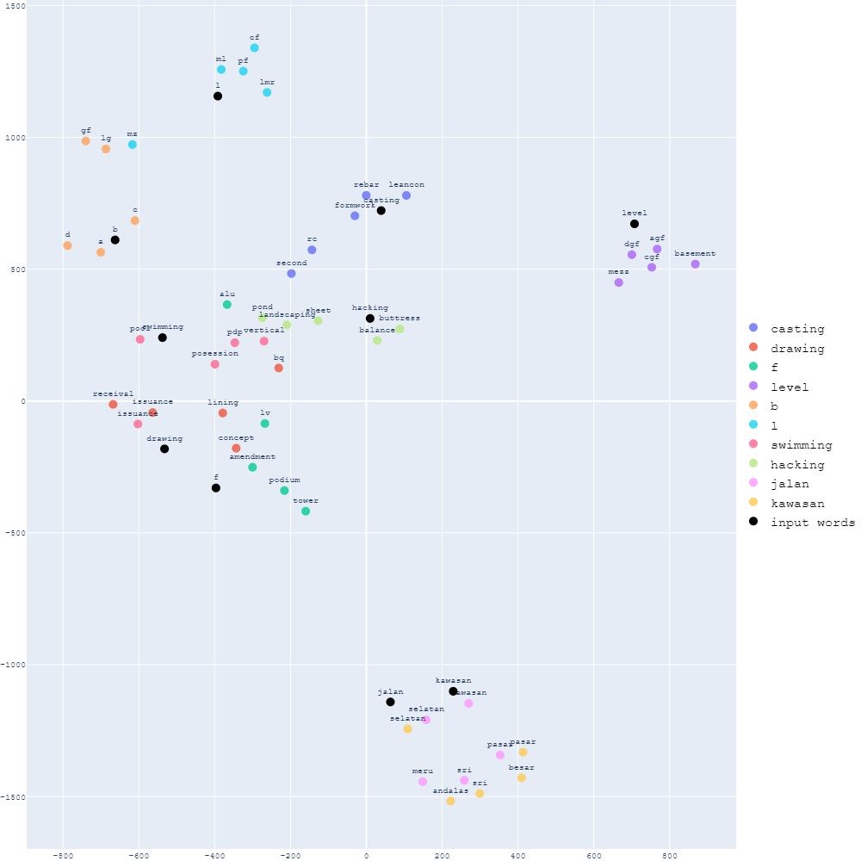
Word2vec similar words graph for Corpus B

Slide 38
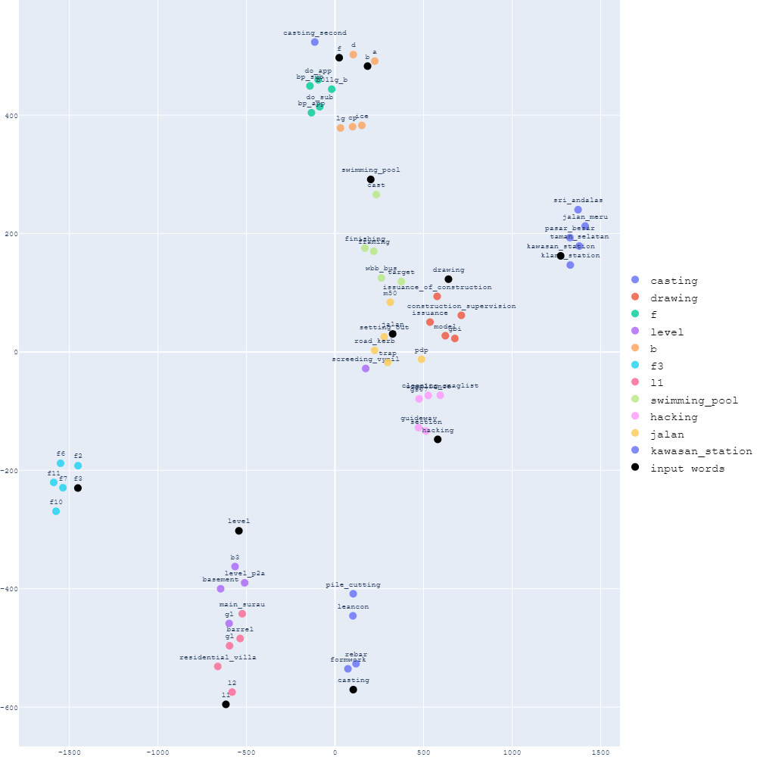
Word2vec with Gensim Phraser similar words graph for Corpus A

Slide 39
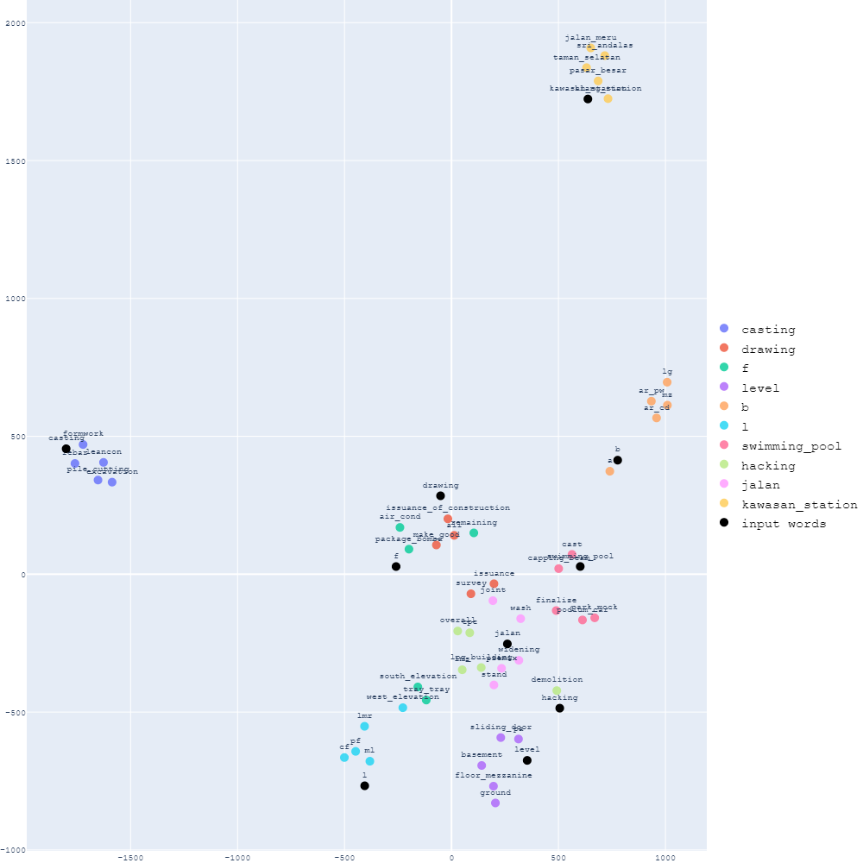
Word2vec with Gensim Phraser similar words graph for Corpus B

Slide 40
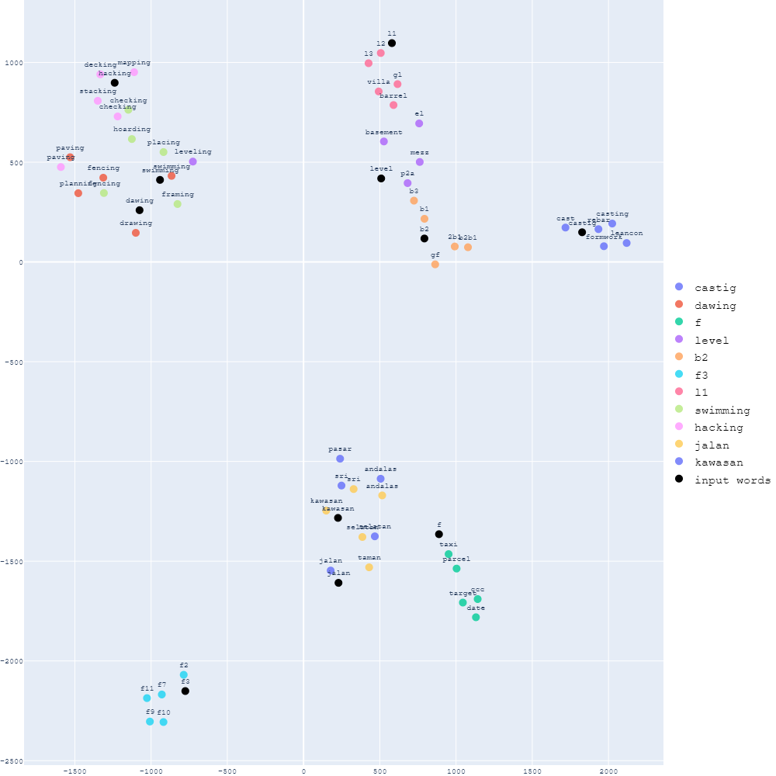
FastText similar words graph for Corpus A

Slide 41
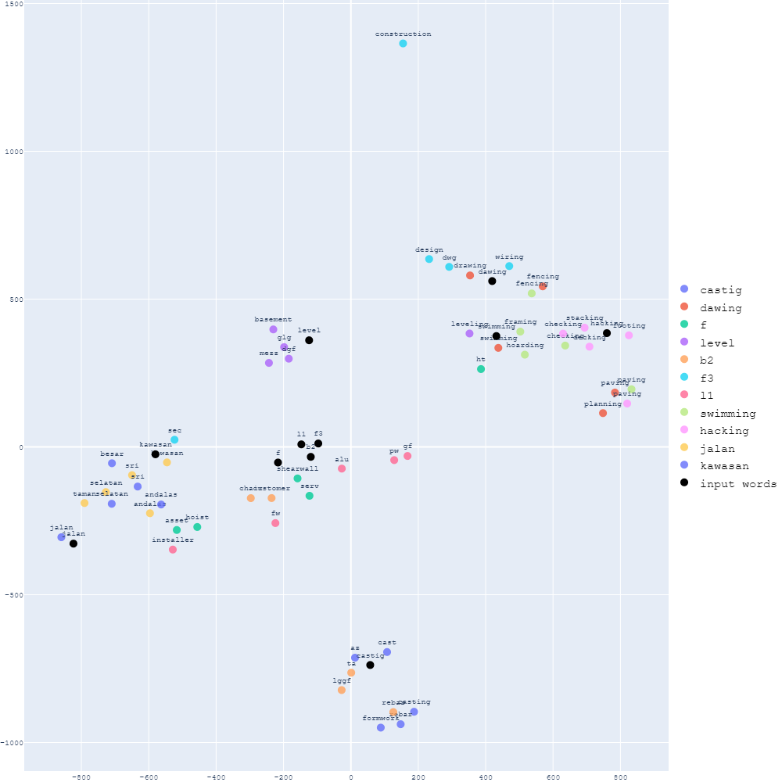
FastText similar words graph for Corpus B

Slide 42
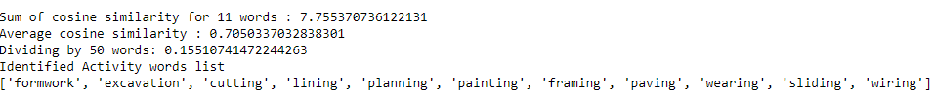

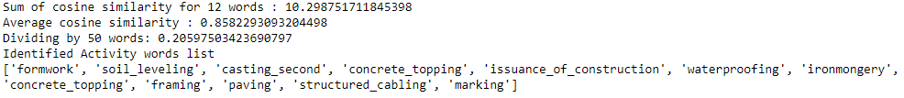
Activity words Comparison for Word2Vec Corpus A
Activity words Comparison for Word2Vec Corpus B
Activity words Comparison for Word2Vec with Gensim Phrases Corpus A

Slide 43
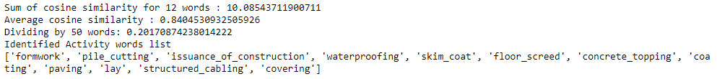
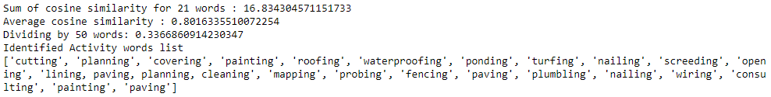
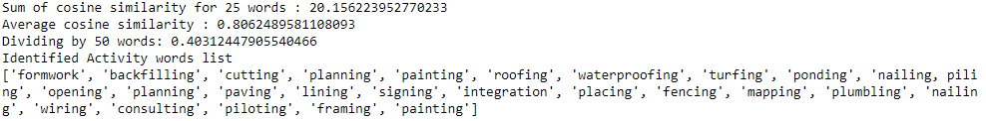
Activity words Comparison for Word2Vec with Gensim Phrases Corpus B
Activity words Comparison for FastText Corpus A
Activity words Comparison for FastText Corpus B

